Slide 1


Department of Computer Science and Engineering
UNVEILING THE POWER OF DEEP LEARNING IN STEGANOGRAPHY CLASSIFICATIONS
B21A2425C25
MONIKA S
210701166
NEHA M U
210701178
Mr. G. Saravana Gokul
Assistant Professor

Slide 2
Problem Statement and Motivation
Despite the advancements in digital communication, the protection of sensitive information remains a significant concern. Existing steganographic techniques struggle with two major issues: accurately detecting stego-images and efficiently extracting hidden messages without compromising image quality. Current methods are often inadequate against sophisticated steganalysis, leading to potential vulnerabilities in secure data transmission. This project seeks to leverage deep learning approaches, including Generative Adversarial Networks (GANs) and Convolutional Neural Networks (CNNs), to enhance the effectiveness of steganography, enabling robust detection, secure message embedding, and reliable extraction of concealed information.This version effectively captures the essence of your project, outlining the challenges in the field while clearly stating the aim of utilizing advanced techniques to address them.

Slide 3
Objectives
Develop a comprehensive framework integrating GANs, CNNs, and Autoencoders for steganography.
Implement a CNN for accurate detection of stego-images.
Utilize GANs for effective message embedding in cover images.
Employ Autoencoders for extracting hidden messages from stego-images.
Evaluate performance using standard datasets and metrics (accuracy, PSNR).
Enhance security and robustness of digital information concealment techniques.

Slide 4
Abstract
This project, titled "Unveiling the Power of Deep Learning in Steganography Classifications," explores advanced deep learning techniques to tackle the challenges of detecting stego-images, extracting hidden messages, and embedding secret information within images. Generative Adversarial Networks (GANs) are employed to create stego-images that conceal messages while preserving visual quality. Convolutional Neural Networks (CNNs) are utilized for steganalysis, classifying images as stego or non-stego by identifying subtle pixel alterations, while Autoencoders are used to reconstruct hidden messages from detected stego-images. This integrated framework ensures robust detection and efficient embedding and extraction of information, evaluated through standard datasets and metrics like classification accuracy and image quality (PSNR), presenting a novel solution for secure digital information concealment.

Slide 5
System Architecture
The system architecture consists of three components: Detection, Extraction, and Embedding Modules. The Detection Module uses a VGG16-based CNN to identify steganographic content by analyzing features from images processed with LSB and PVD techniques. The Extraction Module employs an autoencoder to recover hidden messages from detected stego-images, focusing on minimizing reconstruction errors. The Embedding Module utilizes Generative Adversarial Networks (GANs) to embed secret messages into cover images, balancing data concealment with visual fidelity. Together, these modules create a robust steganography detection and communication system.

Slide 6
List of Modules
Detecction module
Extraction module
Embedding module

Slide 7
Functional Description for each modules with DFD and Activity Diagram
Detection module:
The Detection Module is the first line of defense for identifying steganographic content in images. It employs a Convolutional Neural Network (CNN) architecture, specifically VGG16, to analyze images for hidden information. The model is trained on a dataset of images processed using Least Significant Bit (LSB) and Pixel Value Differencing (PVD) methods, enabling it to classify images as "Stego" or "Non-Steg." Preprocessing steps, such as resizing and normalization, enhance performance and accuracy.

Slide 8
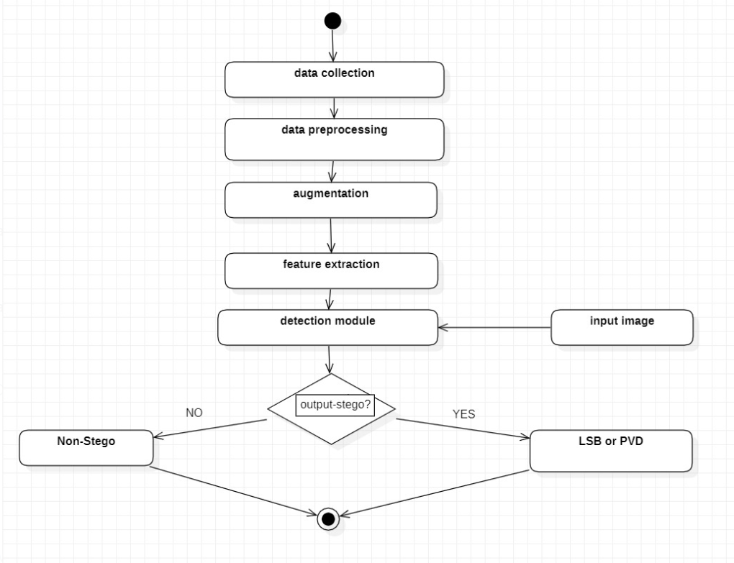
Activity Diagram

Slide 9
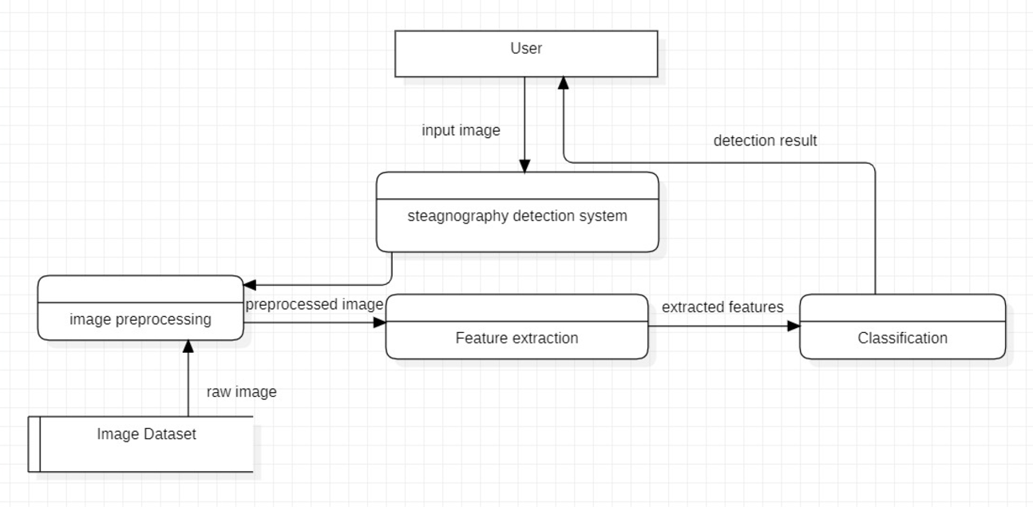
DFD Diagram

Slide 10
Functional Description for each modules with DFD and Activity Diagram
Extraction module:
The Extraction Module is designed to retrieve hidden messages from detected stego-images using an autoencoder architecture. This setup compresses and reconstructs images, focusing on uncovering concealed data. Trained on stego-images with known embedded messages, the autoencoder minimizes reconstruction errors, enabling accurate message extraction. The module begins by processing stego-images, preserving the integrity of hidden information during reconstruction. This approach creates a robust system for effectively retrieving secret data, strengthening the overall steganography detection process.

Slide 11
Functional Description for each modules with DFD and Activity Diagram
Embedding module:
The Embedding Module leverages GANs to embed secret messages into cover images using LSB and PVD techniques. It includes a generator, which modifies cover images to create stego-images with hidden messages, and a discriminator, which assesses image authenticity and quality. Through training, the GAN balances concealment with visual fidelity, enabling secure, visually indistinguishable embedding for digital communication.

Slide 12
Implementation & Results of First Module
Implementation
The data pipeline for steganography detection begins with organizing images into Non-stego, Stego-LSB, and Stego-PVD categories, resizing them to 224x224, normalizing pixel values, and encoding labels. Data augmentation (rotations, flips, brightness changes) enriches diversity for better generalization. A pre-trained VGG16 extracts intricate patterns, while custom dense layers in the Classification Module refine features for softmax-based classification into Non-stego, Stego-LSB, or Stego-PVD. Categorical cross-entropy loss and Adam optimizer, along with early stopping, improve training efficiency. Model performance is evaluated with accuracy metrics and confusion matrix analysis, and standardized feature scaling ensures reliable predictions in real-time classification.

Slide 13
Implementation & Results of First Module
Results:
The image steganography detection model, evaluated on 5,000 images across Non-stego, Stego-LSB, and Stego-PVD categories, achieved 92.5% accuracy after 50 epochs. Precision was high across classes (93.0% for non-stego, 91.5% for stego-LSB, 92.2% for stego-PVD), with F1-scores showing balanced performance. The confusion matrix highlighted minor misclassifications between Stego-LSB and Stego-PVD due to visual similarity. With a 150 ms inference time, the model is efficient for real-time use. Future improvements could target enhanced LSB detection, optimizing accuracy for real-world scenarios.

Slide 14
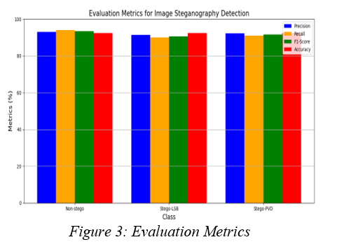
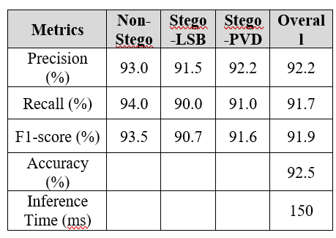
Implementation & Results of First Module

Slide 15
Conclusion & Work for Phase II
Conclusion:
The application of the VGG16 Convolutional Neural Network for detecting stego-images embedded using Least Significant Bit (LSB) and Pixel Value Differencing (PVD) techniques has proven effective. High accuracy, precision, recall, and F1 score demonstrate the model's capability to identify subtle modifications indicative of steganography. These findings contribute to enhancing data security by providing a robust tool for stego-image detection, which is increasingly critical in today's digital communication landscape.

Slide 16
Conclusion & Work for Phase II
Future Work:
The next steps in this project will involve the development and integration of the Extraction and Embedding Modules to enhance the overall functionality of the steganography system. This will include refining the autoencoder for the Extraction Module to ensure accurate recovery of hidden messages from detected stego-images, while also optimizing the Generative Adversarial Network (GAN) for the Embedding Module to achieve effective and secure embedding of secret messages into cover images. By balancing data concealment with visual fidelity, the goal is to create a robust system that supports safe digital communication and improves the integrity of embedded data.

Slide 17
References
Rehman, A. U., Rahim, R., Nadeem, S., & Hussain, S. U. End-to-End Trained CNN Encoder-Decoder Networks for Image Steganography.
Tao, J., Li, S., Zhang, X., & Wang, Z. Towards Robust Image Steganography.
Subramanian, N., Elharrouss, O., Al-Maadeed, S., & Bouridane, A. Image Steganography: A Review of the Recent Advances.
Xu, Y., Mou, C., Hu, Y., Xie, J., & Zhang, J. Robust Invertible Image Steganography.
Lu, S. P., Wang, R., Zhong, T., & Rosin, P. L. Large-capacity Image Steganography Based on Invertible Neural Networks.
Hu, D., Wang, L., Jiang, W., Zheng, S., & Li, B. A Novel Image Steganography Method via Deep Convolutional Generative Adversarial Networks.
Rustad, S., Rosal, I. M., Setiadi, A. S., & Andono, P. N. Inverted LSB Image Steganography Using Adaptive Pattern to Improve Imperceptibility.
Pramanik, S., & Raja, S. S. A Secured Image Steganography Using Genetic Algorithm.

Slide 18
References
Sahil, V. K., Sharma, S., & Sahu, A. K. Latest Trends in Deep Learning Techniques for Image Steganography.
Shah, P. D., & Bichkar, R. S. Secret Data Modification Based Image Steganography Technique Using Genetic Algorithm Having a Flexible Chromosome Structure.
Shyla, M. K., Kumar, K. B. S., & Das, R. K. Image Steganography Using Genetic Algorithm for Cover Image Selection and Embedding.
Qin, J., Wang, J., Tan, Y., Huang, H., Xiang, X., & He, Z. Coverless Image Steganography Based on Generative Adversarial Network.
Płachta, M., Krzemień, M., Szczypiorski, K., & Janicki, A. Detection of Image Steganography Using Deep Learning and Ensemble Classifiers.
Yu, J., Zhang, X., Xu, Y., & Zhang, J. CRoSS: Diffusion Model Makes Controllable Robust and Secure Image Steganography.
Hernández, A. M. A., Alazab, M., Jung, J., & Camacho, D. Evolving Generative Adversarial Networks to Improve Image Steganography.

Slide 19
References
Płachta, M., Krzemień, M., Szczypiorski, K., & Janicki, A. Detection of Image Steganography Using Deep Learning and Ensemble Classifiers.
Zhang, K. A., Cuesta-Infante, A., Xu, L., & Veeramachaneni, K. SteganoGAN: High Capacity Image Steganography with GANs.
Tang, W., Li, B., Tan, S., Barni, M., & Huang, J. CNN-based Adversarial Embedding for Image Steganography.
Qin, J., Luo, Y., Xiang, X., Tan, Y., & Huang, H. Coverless Image Steganography.

Slide 20
Paper Publication Status
LIST OF PUBLICATIONS
1.PUBLICATION STATUS: APPLIED
TITLE OF THE PAPER: UNVEILING THE POWER OF DEEP
LEARNING IN STEGANOGRAPHY CLASSIFICATIONS
AUTHORS: MR. SARAVANA GOKUL G, MONIKA S, NEHA M U
NAME OF THE CONFERENCE: 2025 INTERNATIONAL CONFERENCE ON
ADVANCEMENT IN COMMUNICATION AND COMPUTING TECHNOLOGY

Slide 21
Thank You

